Slide 1
Diabetic neuropathy & Microcurrent
PROPOSED PROJECT
SANTOSH RAJAK
ABHIJIT DUTTA

Slide 2
Diabetic Neuropathy
Diabetic neuropathy is a type of nerve damage that can occur if you have diabetes. High blood sugar (glucose) can injure nerves throughout your body. Diabetic neuropathy most often damages nerves in your legs and feet.
Depending on the affected nerves, diabetic neuropathy symptoms can range from pain and numbness in your legs and feet to problems with your digestive system, urinary tract, blood vessels and heart. Some people have mild symptoms. But for others, diabetic neuropathy can be quite painful and disabling.

Slide 3
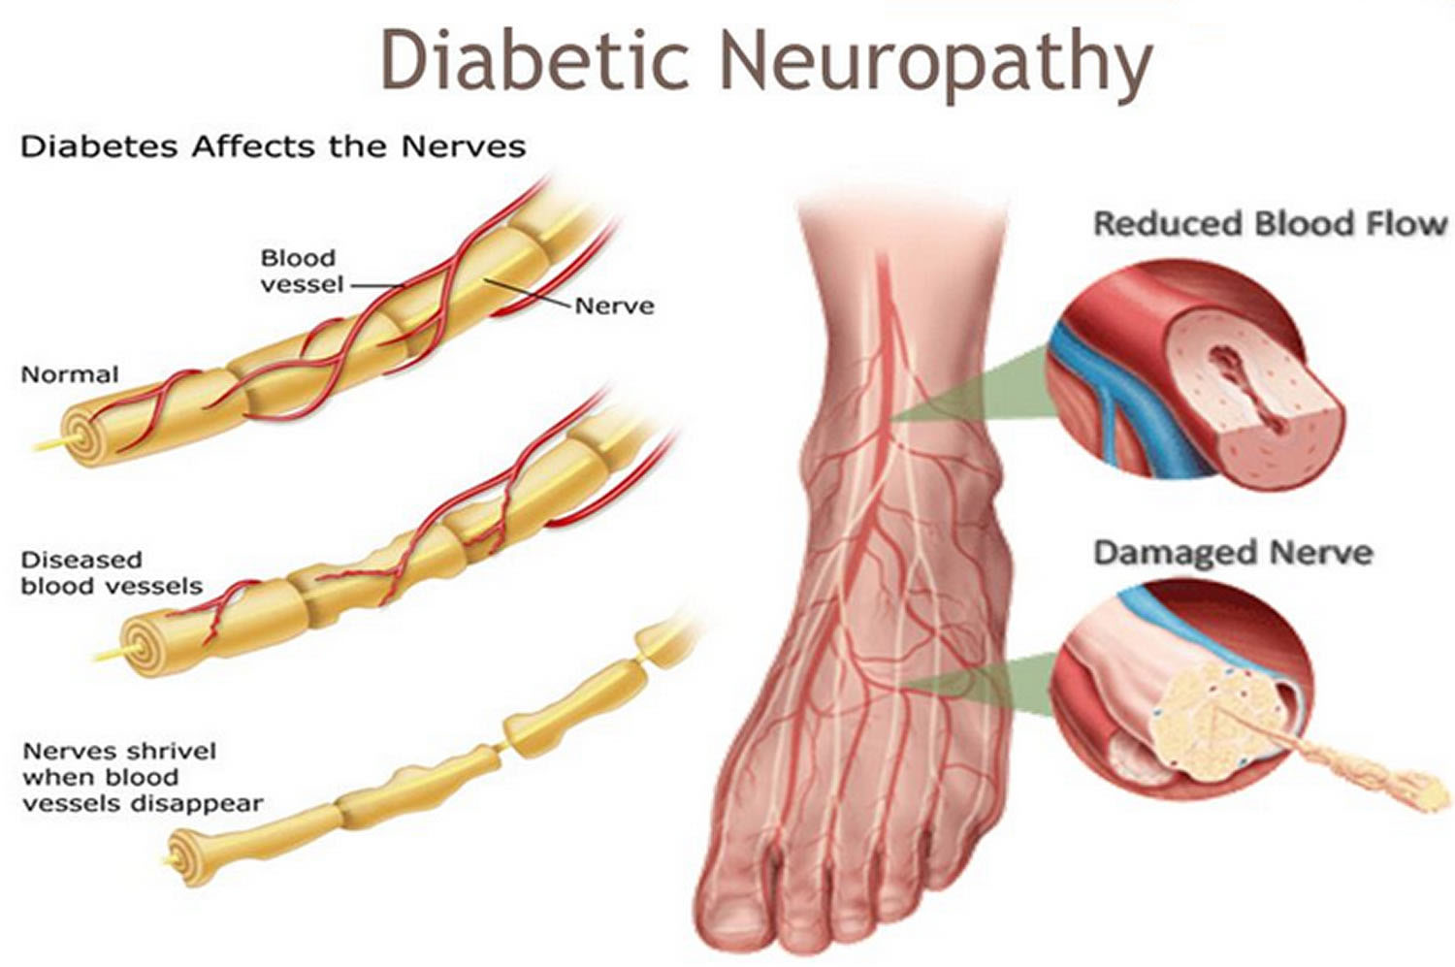

Slide 4
SYMPTOMS
Your symptoms will depend on the type you have and which nerves are affected. Usually, symptoms develop gradually. You may not notice anything is wrong until considerable nerve damage has occurred.
Peripheral neuropathy
This type of neuropathy may also be called distal symmetric peripheral neuropathy. It's the most common type of diabetic neuropathy. It affects the feet and legs first, followed by the hands and arms. Signs and symptoms of peripheral neuropathy are often worse at night, and may include:
Numbness or reduced ability to feel pain or temperature changes
Tingling or burning sensation
Sharp pains or cramps
Increased sensitivity to touch — for some people, even a bedsheet's weight can be painful
Serious foot problems, such as ulcers, infections, and bone and joint pain

Slide 5
Evidence
The Effect of Microcurrent Electrical Stimulation on the Foot Blood Circulation & Pain of Diabetic Neuropathy
https://www.jstage.jst.go.jp/article/jpts/23/3/23_3_515/_pdf#:~:text=Microcurrent%20stimulation%20with%20regular%20walking,foot%20pain%20of%20diabetes%20patients.

Slide 6
Effects and mechanisms of a microcurrent dressing on skin wound healing: a review
https://mmrjournal.biomedcentral.com/articles/10.1186/2054-9369-1-24

Slide 7
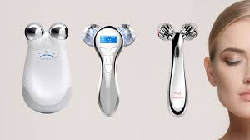
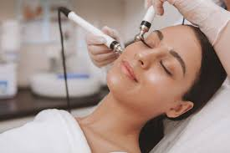

Slide 8
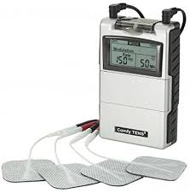

Slide 9
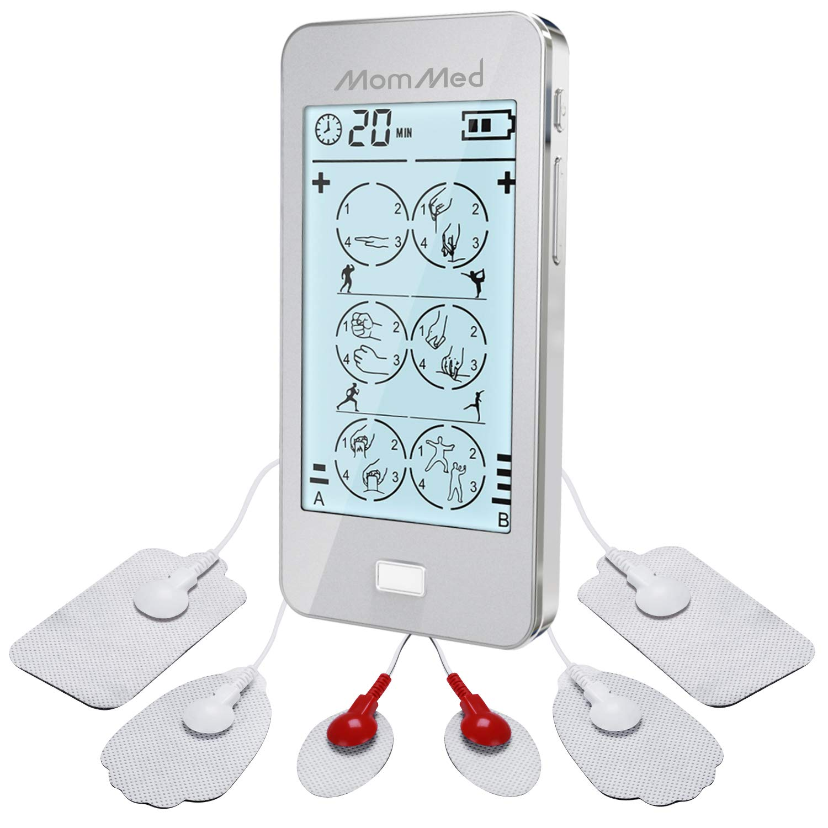

Slide 10
Characterstic
Portable
Easy to use
Power/ battery operated
Microcuurent
Controls
Reusable Electrodes

